Slide 1
INDUSTRIAL PSYCHOLOGY
POST GRADUATE DIPLOMA IN MANAGEMENT
(PGDM)
SOPHITORIUM MANAGEMENT COLLEGE

Slide 11
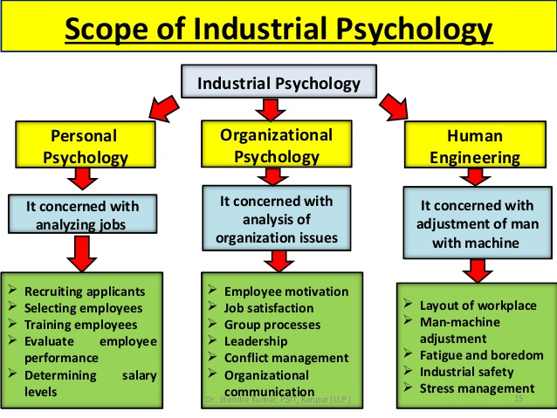

Slide 14
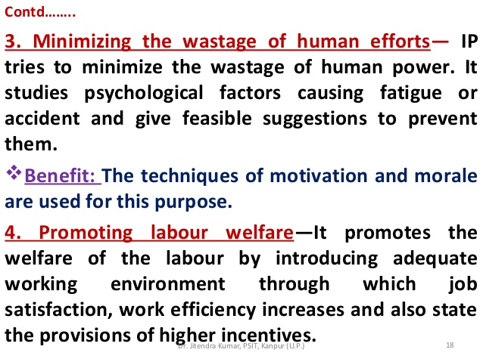

Slide 17
THANK YOU

